Slide 1
CS496: Introduction to Machine Learning
(Selected Topic in CS)
Course Introduction
Nopadon Juneam

Slide 2
About the Course
Course description:
This course provides a broad introduction to the field of Machine Learning (ML).
Course objectives:
To teach you basic skills to decide which ML algorithm to use for what problem, code up your own ML algorithm and evaluate and debug it.
** This course is not a practical ML course (many good online courses are already out there!!).

Slide 3
Pre-requisites
Students are expected to have the following background:
Knowledge of programming skills to write a program using Python/Numpy.
Knowledge of basic Data Structures and Algorithms.
Familiarity with Probability Theory and Statistics.
Familiarity with Multivariable Calculus and Linear Algebra.

Slide 4
Logistics
Google classroom: dc4pwox (for class code)
Online class alternating physical class are planned until midterm (changes may be made upon the future university’s policy).
For online class, each lecture video will be about ~1 hr long, and will be posted on Google classroom on the day before the actual class day.
Live discussion session for Q&A (about ~0.5 hr long) will be arranged on the class day.
My office hours: Thursday 10.00-12.00; SC45-772

Slide 5
Course Topics (not in order)
Supervised Learning Setup
Nearest Neighbors
Perceptron
Estimating Probabilities from data
Bayes Classifier and Naive Bayes
Logistic Regression
Gradient Descent
Linear Regression
Support Vector Machine
Neural Networks
Deep Learning
Model Selection
Etc.

Slide 6
Course Materials (1)
We will follow the materials from the following courses:
(Mostly) Cornell’s University’s CS4780 Fall 2018 (https://www.cs.cornell.edu/courses/cs4780/2018fa/)
(Partially) Stanford University’s CS229 Summer 2020 (http://cs229.stanford.edu/syllabus-summer2020.html)
(Partially) University of Toronto’s CS411 Fall 2017 (https://www.cs.toronto.edu/~jlucas/teaching/csc411/)

Slide 7
Course Materials (2)
Suggested reading:
Kevin Murphy’s book “Machine Learning: A Probabilistic Perspective” (https://www.amazon.com/Machine-Learning-Probabilistic-Perspective-Computation/dp/0262018020)
CS229 Lecture notes by Andrew Ng (http://cs229.stanford.edu/summer2020/cs229-notes1.pdf)

Slide 8
Course Structure
15 weeks
Assignments: 40%(independent)
Midterm exam: 20%
Final exam: 20%
Project: 20%(group of two)
** A minimum of 50% will be needed to be scored to pass the course.
A | Curve-based evaluation
B+
B
C+
C
D+
D
F | < 50%

Slide 9
Part I
Machine Learning?

Slide 10
Traditional Computer Science
Data
Output
Program
Computer

Slide 11
Specific Problem Type
Decide whether a patient has Alzheimer given his MRI image.
Data (input)
Output (yes/no)
Program?
Computer

Slide 12
Machine Learning: Training
Data
Program (literally can’t be hard code)
Output
Computer

Slide 13
Machine Learning: Testing
Unseen data
Output
Program
Computer

Slide 14
Machine Learning Approach
Unseen data
Data
Output
Program
Output
Computer
Computer
Testing
Training
At first, it was the crazy idea!!

Slide 15
Machine Learning’s Definitions
Formal: (Tom Mitchell 1997) A computer program is said to learn from experience E with respect to some class of tasks T and performance measure P, if its performance at tasks in T, as measured by P, improves with experience E.
Informal: Algorithms that improve on some tasks with experience.
More data (more experience)
Better program

Slide 16
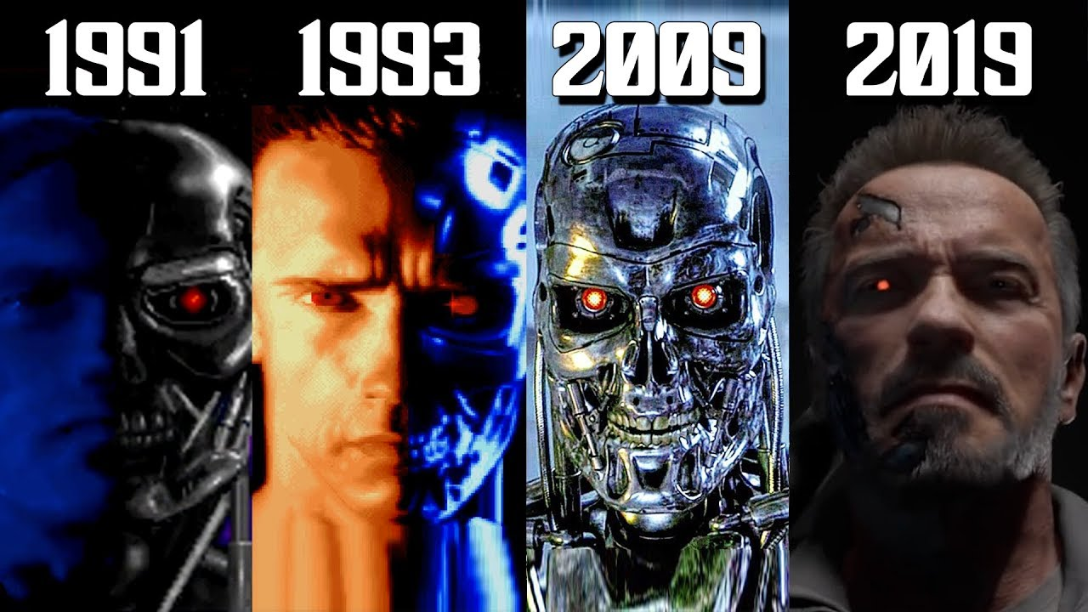
Part II
A (brief) History of ML

Slide 17
Samuel’s Checker Player
(1952)
The first algorithm that learned from experience.
Basically, Shannon’s minimax algorithm (traditional AI).
Player improved over time.
Already a solved problem.

Slide 18
Perceptron
By Frank Rosenblatt (1957)
An ML algorithm used until today (evolved to Neural Networks and Deep Learning).
Revolutionary at the time.
Needed computers with high computational power which none existed.
A huge wave of excitement came after.

Slide 19
AI Winter
By Minsky & Papert (1969)
“Killed” AI paper (Single-layer perceptron can’t do XOR)
Burst huge expectation bubble
Caused funding for AI research to collapse for decades

Slide 20
Rebirth as “Machine Learning”
Artificial Intelligence
Originally: A name game to get funding.
Profound difference:
AI: Focus on humans.
ML: Learn something from data.
More practical, smaller goals.
Based on “Statistics, Optimization, not Logics.”
Machine Learning

Slide 21
TD-Gammon
By Gerald Tesauro (1992)
IBM’s Backgammon player
Taught a neural network to play Backgammon against itself 100K+ games and beat world champion.
Revealed advances in the theory of Backgammon play.

Slide 22
Deep Blue
By IBM (1997)
Won against Garry Kasparov (Russian’s world champion in chess).

Slide 23
Today
ML is everywhere:
Web search (personalized search engine)
Spam Filter (filter emails you don’t want)
Autonomous cars (soon)
Etc.

Slide 24
When will it stop?
Well, human brain is one big ML. (We can still do a lot better !!)
Designing new ML algorithms is very hard. Only very few people can design them.
But many people can use them.

Slide 25
Types of Machine Learning
Supervised learning: Given labeled examples, find the right prediction of an unlabeled example.
E.g. Given annotated images, learn to detect faces.
Unsupervised learning: Given data, try to discover similar patterns, structure, sub-spaces.
E.g. Automatically group news articles by topics.
Reinforcement learning: Try to learn from delayed feedback.
E.g. UAV learns to fly.

Slide 26
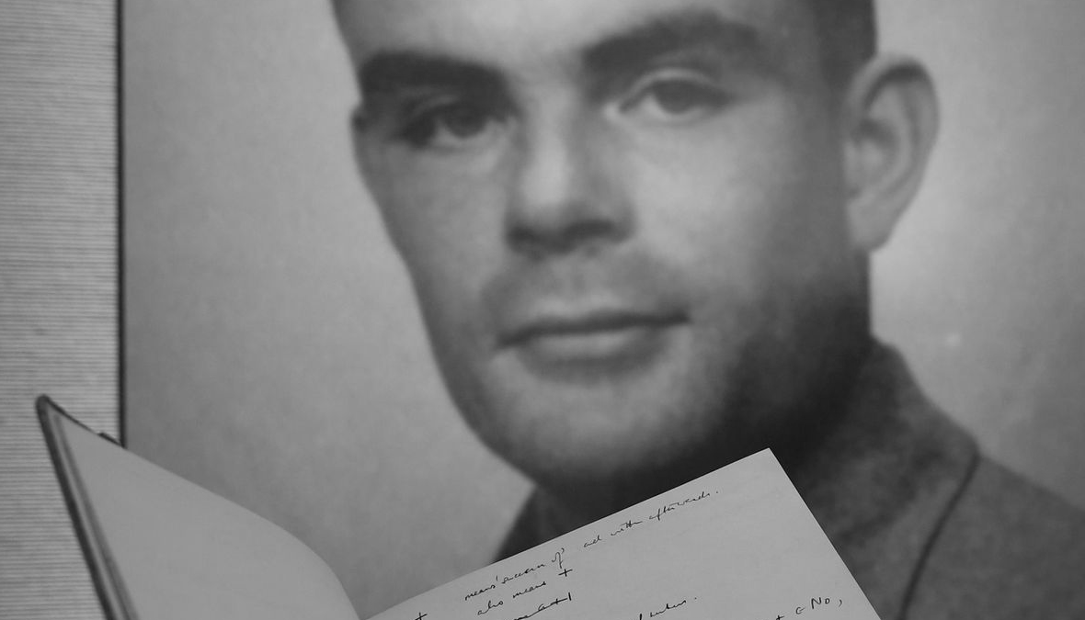
“What we want is a machine that can learn from experience.”
Alun Turing (1947)

